Slide 1
We want to turn Lunchtimes into Happy Lunchtimes

Slide 2
Noise-o-meter
Behaviour Expectations
The Zone
Certificate in Assembly
Happy Lunchtimes
PomPoms Challenge
Table of
Awesomeness
Golden Lunchbox Class Reward
Golden Lunchbox Award

Slide 3
Lunchtime Survey
We asked your opinion on lunchtimes and this is what you shared:
20% of the whole school scored the playground experience as ‘good’. 53% felt the playground at lunchtime ‘is ok’.
Only 7% of the whole school feel the dining hall experience at lunchtime is ‘good’ with 35% whole school and 59% of KS1 voting ‘not much’.
What you would like to keep about Lunchtimes:
Peer Mediators
Play Leaders
Singing Playgrounds
Play equipment and climbing frames
The Quiet Area
VIP table
Buddy Bench
What you would like to see change:
More thoughtful behaviour towards each other
Quieter and calmer dinner hall.
Better table manners
More variety on the playground.
5. Improvements to The Quiet Area
6. Improvements to the Buddy Bench.
7. More time to resolve conflicts

Slide 4
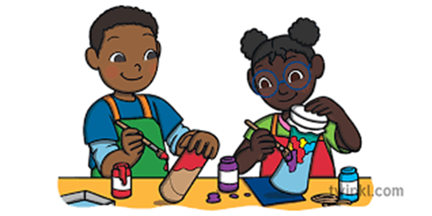
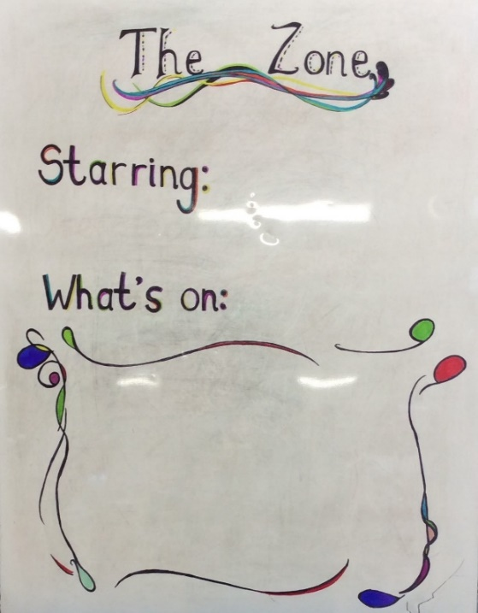
Creative Play
The Zone
Every day there will be a different activity in ‘The Zone’ to suit all personalities.
Active Play
Construction Play
Quiet Play
Imaginative Play
Competitive Play
Variety is the spice of life

Slide 5
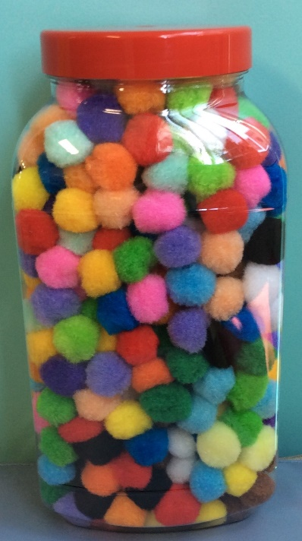
PomPoms Challenge
Middays will be giving out PomPoms to children making good choices at lunchtime.
The class with the most PomPoms will win the ‘Golden Lunchbox’ and be awarded a mystery 15 minute reward.
Golden Lunchbox Class Reward
Golden Lunchbox Award

Slide 6
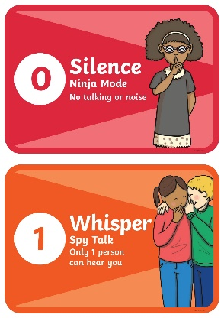
Noise-o-meter
You asked for help in keeping the dinner hall calm and quiet during lunch. From now will speaking at Spy Mode during lunchtimes in the hall. Spy Mode means to whisper so only one person can hear you.
Whole School Weekly Challenge: Stay at Spy Mode for 5 days in a row and earn 10 minutes extra play.
The middays will help you by doing a countdown and showing you an orange ‘spy mode’ card as a reminder to whisper in the hall.
If you don’t whisper in the hall and the middays need show you a red, Ninja mode card you earn a bomb and fail the challenge for the week.
Everyday that you stay at Spy Mode you will be given a gold star.
Can you get 5 stars in row and earned the Spy Mode reward?
Red card
Ninja Mode =
= 10 minutes extra play
Orange card
Spy Mode =

Slide 7
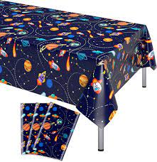
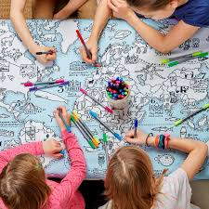
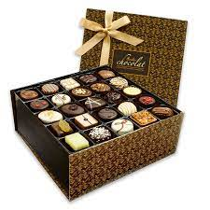
Table of
Awesomeness
One lunchtime a term the middays will choose 2 children each to sit on the ‘Table of Awesomeness’.
They will be choosing children who are Awesome at lunchtimes by being kind, playing well with others, using good table manners, looking after each other and equipment and generally making good choices on the playground and in the hall every lunchtime.

Slide 8
Certificate in Assembly
The Happy Lunchtimes Award
Each midday will choose one child who has shown golden behaviour at lunchtimes to receive a ‘Happy Lunchtimes’ Certificate in Monday’s Celebration Assembly.
Patience
Bravery
Fairness
Kindness
Gratitude
Teamwork
Good manners

Slide 9
Our rules stay the same….
Behaviour Expectations
Golden Behaviours I am following instructions I am showing good manners I am looking after our school I am showing respect to others I am showing good sitting, looking and listening. | If you unintentionally break a rule then the adult will have a quiet word with you. If it is a well known school rule that is broken then you have intentionally broken that rule and it is a 2 minutes Time In. | I am not following instructions I am not showing good manners I am not looking after our school I am not showing respect to others I am not showing good sitting, looking and listening. I have used unkind words. | I continue to not follow instructions I continue to not show good manners I continue to not look after our school I continue to not show respect to others I have physically hurt someone. I have used racist or homophobic words
1. If you choose not to follow the school rules you will be asked to do a Time In with the adult who gave it you. Once that 2 minutes is up you can go back and play.
2. If you refuse to do your 2 minute Time in with the adult you will be sent to Mrs Lusty or Miss Rouse. Your time will be extended to 5 minutes AND THEN you will go serve the original 2 minutes with the midday that spoke to you.
Refusing to listen to a midday = 5 min Time In + then 2 min Time In with the midday.
Serious behaviours such as spitting, swearing, hurting others or bullying is an Instant 5 minute Time In
Serious behaviour = Instant 5 min Time In
If you earn 3 lots of 2 minute Time Ins at lunchtime in one week then a text will be sent home.
X3 ‘5 minute Time Ins’ in a week = Text to parents
.
PomPoms Golden Lunchbox HL Certificate Spy Mode Reward Table ofAwesomeness | Quiet word | 2 min Time In | 5 min Time In

